Slide 1
Regression

Slide 2
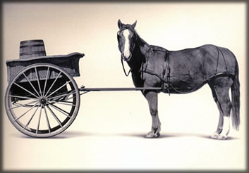
Let’s Practice
Open A_Regression.R
Predict Diamond Prices with linear regression.

Slide 3
The Problem of Overfitting
Statistical models can produce highly complex explanations of relationships between variables
The “fit” may be excellent
When used with new data, models of great complexity may do not do so well.
Notes:
3

Slide 4
100% fit – not useful for new data
Notes:
4

Slide 5
Another view of overfitting to a problem…

Slide 6
Minimize Overfitting - Partitioning
Divide data into training portion and validation portion
Test model on the test portion
Training Data
All Data
Test Data
Notes:
How do you want to “spend” data

Slide 7
Minimize Overfitting - Partitioning
Divide data into training portion , validation & test portions
Tune a model and/or compare models with the validation portion
The “true” way a model will behave when launched on new data.
Training Data
All Data
Validation
Data
Test Data
Notes:
How do you want to “spend” data

Slide 8
Best Practice
If you have enough data and the model impact is large, this is a good partitioning schema
However, this much effort is not always undertaken.
Feature Engineering
Data
Training Data
All Data
Validation Data
Test Data
Notes:
How do you want to “spend” data
For large data – production, 10% improvement = $500M; 10% overfitting = $-500m
Additional layer of partitionoing CV discussed later

Slide 9


Supervised Learning
Inferring a function from labeled data.
“Learn from telling”, “Look at my data and I will tell you what to predict”
Data Setup
Algorithm
Business Context
Application
Marketing-Will a customer buy yes or no? How much will a customer spend?
Operations- Will an applicant default? When will a machine break?
Sports Analytics- How many points will the Bears’ QB score? What is the Bears’ probability of winning?
Requires expertise and stakeholder buy in
Flat “Excel” file. Each row is a record or observation. Each column is an attribute of the record.
One column is the outcome, y or target attribute.
Modeling e.g. K-NN, linear regression, decision tree, random forest etc.
Use the model to make predictions for the target label on the new data.

Slide 10

Supervised Learning Example
Inferring a function from labeled data.
“Learn from telling”, “Look at my data and I will tell you what to predict”
What impacts ice cream sales?
#
=ƒ(…)
Notes:
Just did carat to diamond prices
Now let’s add more than 1 input

Slide 11
Linear Regression for continuous outcomes
#
= $β$ + ($β$*temperature) + ($β$*day) + ($β$*price) + error
Some linear combination of temperature values, day of the week dummy variables and price estimate the number of cones that will sell.
Notes:
What should we expect the beta signs to be? Whats the relationship the information has with ice cream sales?
Temp goes up? Sales go up. Temp goes down? Sales go down. Positive relationship
Price goes up? Sales go down. Price goes down? Sales go up. Negative relationship

Slide 12
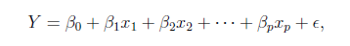
The linear combination equation captures information
outcome
coefficients
constant
error (noise)
predictors

Slide 13
The linear combination equation captures information
Outcome:
The “dependent”, “y” or “target”.
Number of Ice Cream Cones

Slide 14
The linear combination equation captures information
Constant:
The “intercept” or “beta-naught” has no predictor associated with it.
Avg. Number of Ice Cream Cones expected to sell if predictors were all 0.

Slide 15
The linear combination equation captures information
Predictors:
The “informative features”, “x” or “independent” variables.
Variables affecting sales in the data, temp, day, & price.

Slide 16
The linear combination equation captures information
Coefficients:
The “weight”, “betas” or “coefficients” multiplied with the specific “x” variable value.

Slide 17
The linear combination equation captures information
Error:
The “error” or “noise” represents the value the equation is wrong compared to the actual Y.

Slide 18
The linear combination equation captures information
outcome
coefficients
constant
error (noise)
predictors
The combinations of beta coefficients seeks to minimize the squared errors between the actual Y values and the equation. This combination manifests as the “best fit line”

Slide 19
#
= $6$ + 0.$25$*temperature + $3$*satudray_dummy + -0.5*price
Beta-Naught | Temperature | Saturday_dummy | Price
6 | 0.25 * 80 degrees | 3 * 1 | -0.5 * 5
6 | 0.25 * 88 | 3 * 0 | -0.5 * 2

Slide 20
#
= $6$ + 0.$25$*temperature + $3$*satudray_dummy + -0.5*price
Beta-Naught | Temperature | Satuday_dummy | Price | Best Fit Prediction
6 | 0.25 * 80 degrees | 3 * 1 | -0.5 * 5 | 26.5
6 | 0.25 * 88 | 3 * 0 | -0.5 * 2 | 27

Slide 21
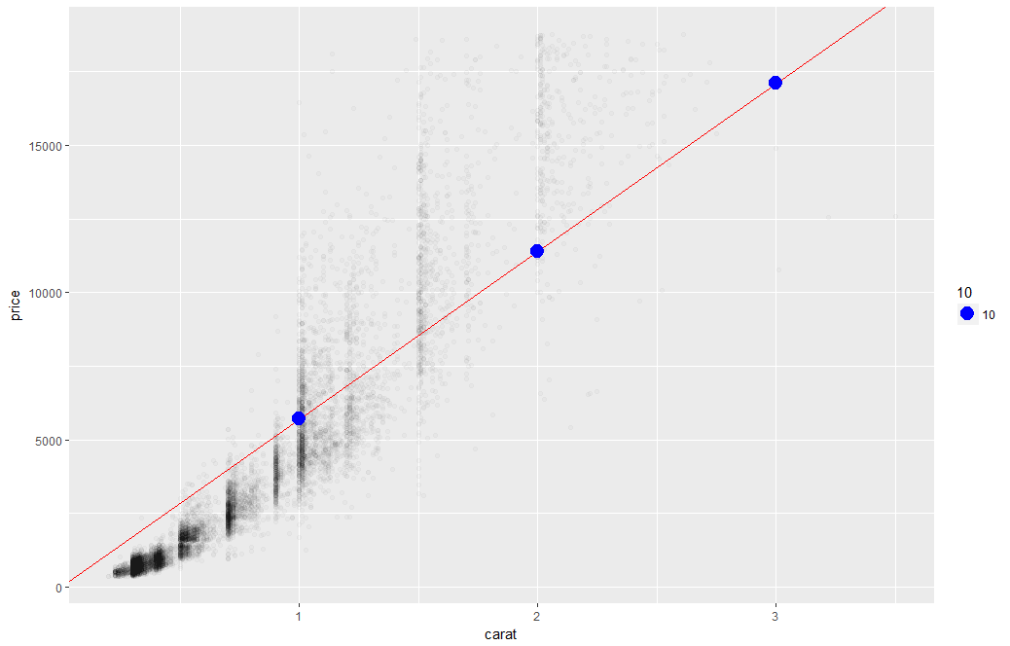
What’s really going on?
Errors between a prediction and actual.
Notice some are negative and some are positive

Slide 22
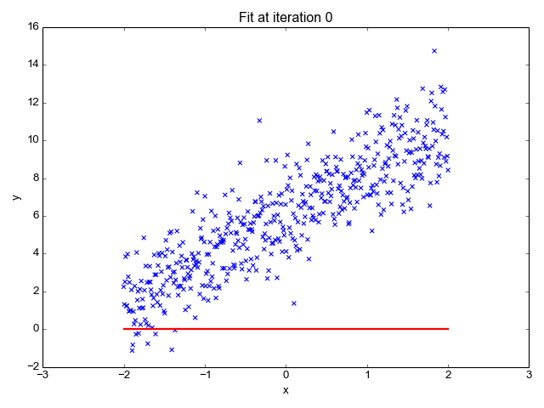
So what is really going on?
The algorithm is optimizing the inputs and weights (beta’s) to minimize the sum of squared errors.
This is called “ordinary least squares (OLS).

Slide 23
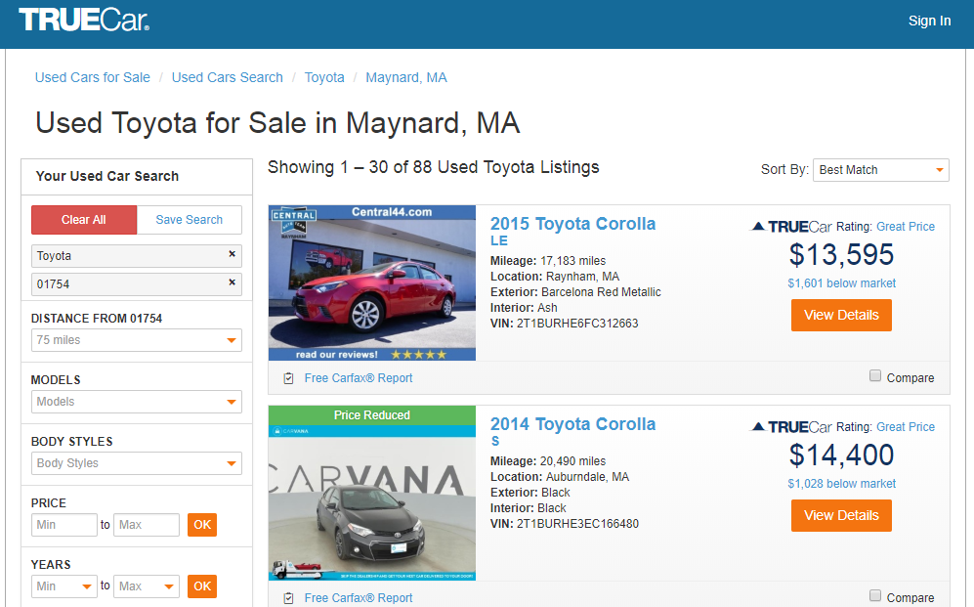
How does truecar.com know the price is “great?”

Slide 24

Yeah! I got a new job!

Slide 25

Welcome Dale to TrueCar’s Competitor: OldCar
Dale, can you predict used car prices? Then we will know if a car is priced above/below expected value

Slide 26

Let’s help Dale again.
But of course. This sounds like a predictive modeling project.

Slide 27
Modeling Process
SEMMA (from SAS)
In this course…
1. Sample
In this course, most data sets are curated for you, but partitioning is done to avoid overfitting.
2. Explore
As part of your analysis you perform basic exploratory data analysis (EDA)
3. Modify
Data Processing: cleanup, dimension reduction, feature engineering & feature enrichment
We will just use library(vtreat) for variable treatment
4. Model
You will learn regression, logistic regression, decision tree and random forest. You are expected to try all that are appropriate.
5. Assess
Many KPI, but in this intro class we will use Accuracy for classification and RMSE, MAPE for regression

Slide 28
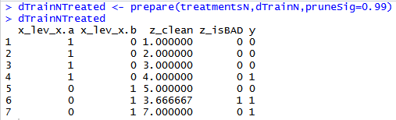
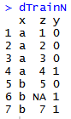
Variable Treatment: library(vtreat)
Vtreat automates some data cleaning, imputation and engineers specific response encoded variables.
Step 3
treatmentsN <- designTreatmentsN(...)
“Prepare” Data into a treated Modeling Matrix
Step 2
“Design Treatment” - Categorical or Numeric outcome
Step 1
Organize Informative Data

Slide 29
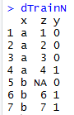
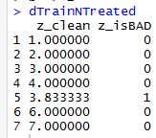
Mean Imputation - PreProcessing
Most of the time we will use vtreat to clean data…its faster and easier.
Vtreat Actions | Common Name
NA, NAN, and Infinity replaced with mean | Mean imputation
When a numeric value is missing
Replace that value with the mean average
Not applicable for categorical variables
Design a treatment plan and apply it.
Kwartler

Slide 30
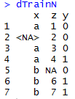
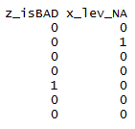
Missing Flags- PreProcessing
Vtreat Actions | Common Name
Indicator | Missing indicator
When a numeric value is missing
Add a missing flag variable
When a factor level is missing
Add a missing flag variable
Design a treatment plan and apply it.
Kwartler

Slide 31
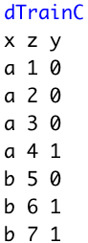
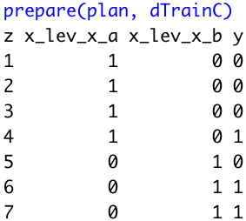
Dummy Variables - PreProcessing
Vtreat Actions | Common Name
Indicator variables | Dummy variable
Not applicable for numeric values
For each factor level, will create dummy variables.
Design a treatment plan and apply it.
Beware! Since some algorithms don’t care, vtreat will return ALL dummy variables and not drop one to represent all 0s.
Kwartler

Slide 32
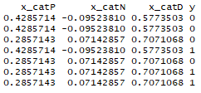
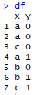
Vtreat Engineered CAT Variables Example
Simple Calculations
The propensity of A to Y=1 is less than average Y’s occurence
CatN (Numeric):
X equals A & Y equals 1: (1/3) minus
Overall Y value equals 1: (3/7)
0.33 - .42 =
-0.0952381
Step 3*
“Prepare” Data into a treated Modeling Matrix
*abridged data shown
Step 2
“Design Treatment” - Categorical or Numeric
treatmentsN <- designTreatmentsN(...)
Step 1
Organize a Modeling Matrix
For each category level, what’s the difference between its proportion of success compared to the overall, natural propensity for success in the data.
Kwartler

Slide 33
Vtreat Engineered CAT Variables Example
Simple Calculations
The standard deviation of Y for level B captures the relationship’s distribution
CatD (Deviation):
Level B sd(c(0,1)) = 0.7071068
Step 3*
“Prepare” Data into a treated Modeling Matrix
*abridged data shown
Step 2
“Design Treatment” - Categorical or Numeric
treatmentsN <- designTreatmentsN(...)
Step 1
Organize a Modeling Matrix
For each category level how diffuse is the relationship with the success outcome.
Kwartler

Slide 34
Vtreat Engineered CAT Variables Example
Simple Calculations
How prevelant is C among all observations i.e. is it a rare event?
Cat P (Prevalence):
Level C Occurred (2/7) = 0.2857143
Step 3*
“Prepare” Data into a treated Modeling Matrix
*abridged data shown
Step 2
“Design Treatment” - Categorical or Numeric
treatmentsN <- designTreatmentsN(...)
Step 1
Organize a Modeling Matrix
For each category level, whats the natural propensity for success.
Kwartler

Slide 35
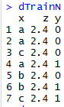
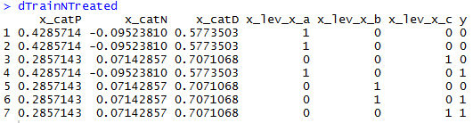
Non-Informative Check
Vtreat Actions | Common Name
Constant/Near Constant | Suppress uninformative variables
Z is automatically dropped.
In this fake example, since z contains a constant value an algorithm can’t learn from it.
Kwartler CSCI 96

Slide 36
Vtreat adjusts data in many ways.
Action | Type | Description
Imputation | Cleaning | Na, Nan, Inf replacement with mean
Imputation Indicator | Cleaning | Append a binary column as imputation flag
Dummy Variables | Cleaning | Create dummy variables for categorical variables
Constant Attribute Suppression | Cleaning | Remove variables with a single value.
Level Deviation –”cat_D” | Engineering | A “deviation fact” about a categorical level. Tells us if ‘y’ is concentrated or diffuse when conditioned on the observed level of the original categorical variable.
Level Prevalence- “cat_P” | Engineering | A “prevalence fact” about a categorical level. Tells us if the original level was rare or common.
Estimated Single Variable Effects – “cat_B” = categorical outcome w/Bayesian “cat_N” = numeric outcome w/Regression | Engineering | A single variable Bayesian model of the change in logit-odds in outcome from mean distribution conditioned on the observed value of the original variable. A single variable regression model of the difference in outcome expectation conditioned on the observed value of the original variable.
Rare Cats* | Engineering | For categorical levels below a frequency threshold, pool different levels into a common “rare-level” variable
Notes:
Does NOT check for co-linear variables
Does not perform outlier suppression

Slide 37
Why is Feature Engineering & Enrichment Effective?
$$f\left(Modeling Results\right)=the Algo+Parameters+Data provided$$
Better features means flexibility.
less than optimal models can still yield good results
Betters features means simpler models.
less than optimal parameters can still yield good results
Better features means better results.
“The algorithms we used are very standard for Kagglers. We spent most of our efforts in feature engineering.” Xavier Conort describing his winning “Flight Quest” submission
Way to differentiate & squeeze out more accuracy
Kwartler

Slide 38
Data Enrichment aids Model Performance
Feature Enrichment is the act of adding new information to your dataset. You are enriching your existing data, often with public or 3rd party data.
Existing Data
New Data
There are limits to what an organization has internally for data.
Companies exist solely to enrich data sources.
Kwartler

Slide 39
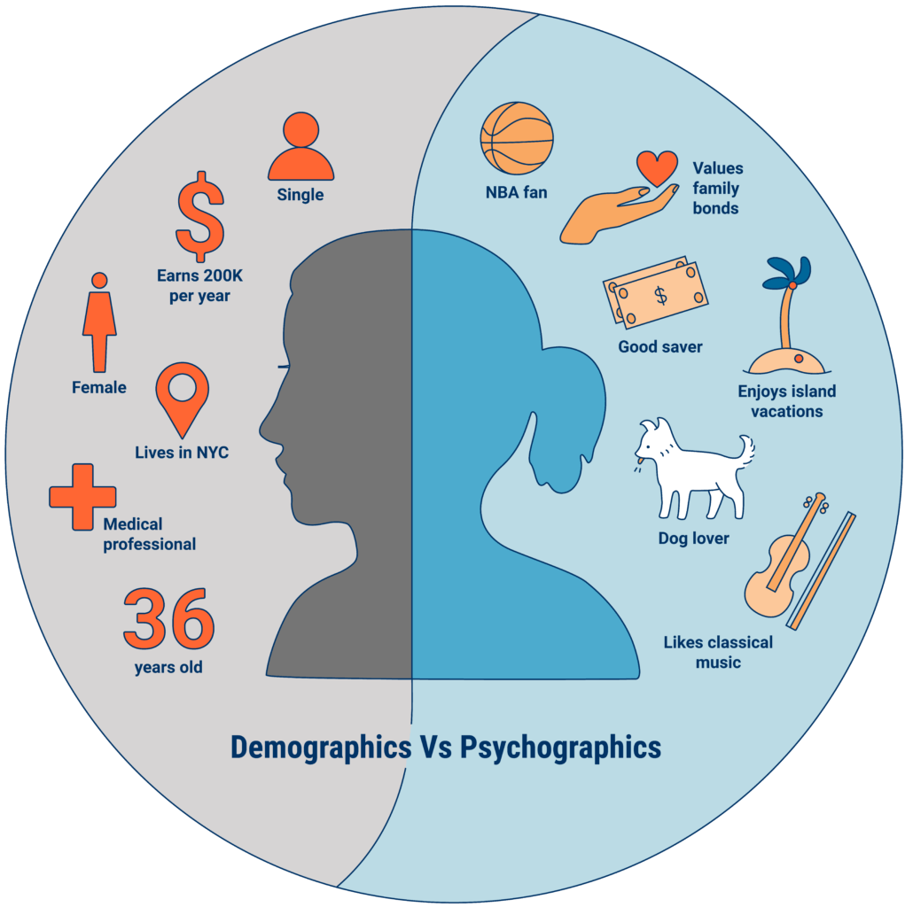
An example of Data Enrichment
They could buy data about employees to have a more complete picture.
An organization may collect some information about employees during interactions.
https://www.cbinsights.com/research/what-is-psychographics/
Kwartler

Slide 40


Modeling with Feature Enrichment is Widespread
Used social media information of individual and friends to model voting tendencies
Uses 3rd party data to predict if a household member has diabetes for marketing.
Most consumers are not aware the type and amount of data that is available about them.
Kwartler

Slide 41

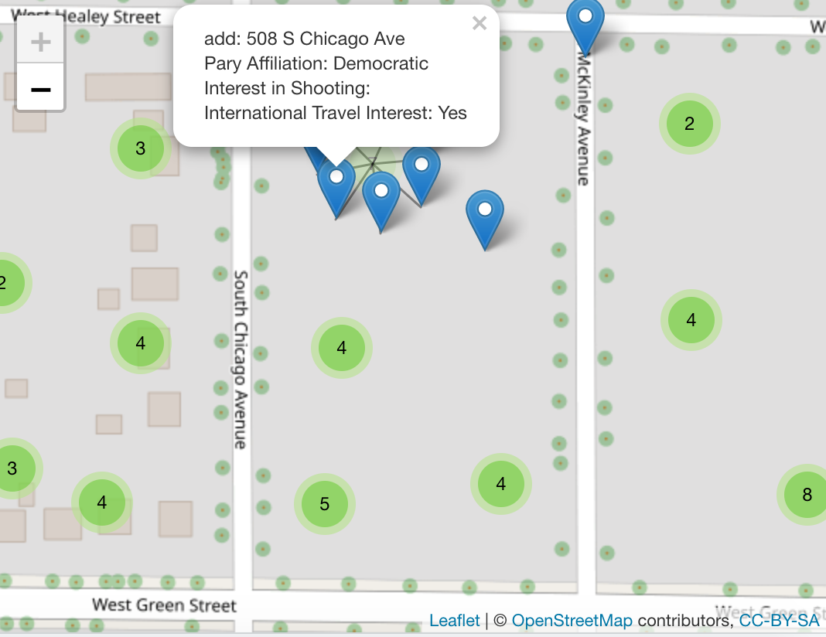
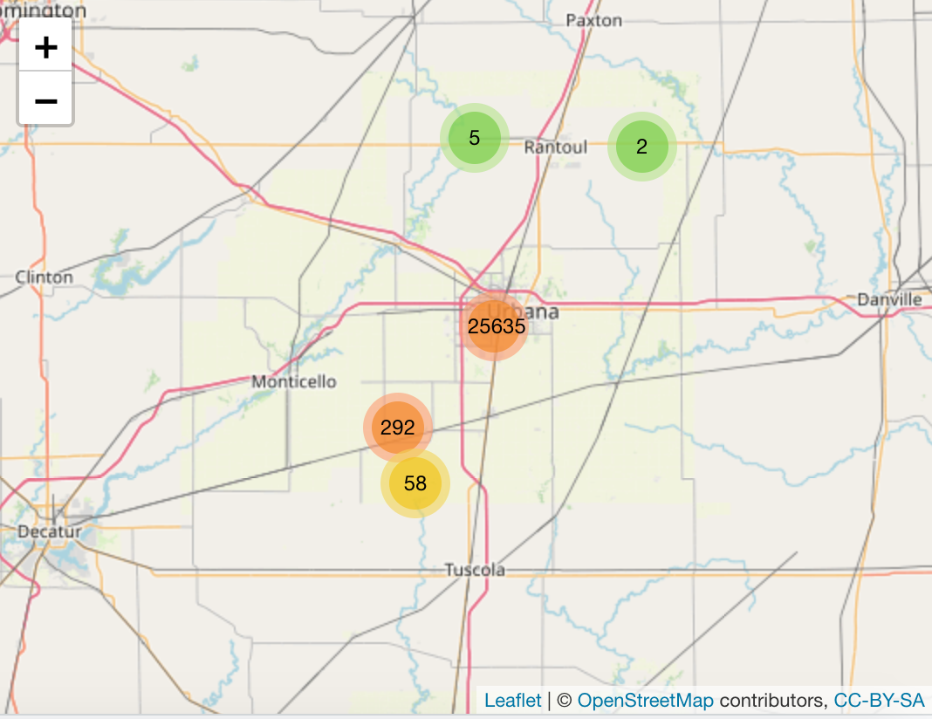
Additional Examples
26000 households in 1 Congressional District
550+ variables
$2500
Dynamic Map with any fields==10 lines of code!

Slide 42
Let’s practice.
Open B_newCar.R
Using the preprocessing and partitioning code in your toolbox, create a linear model of Toyota prices with engineered variables from vtreat..

Slide 43

Regression is susceptible to multi-colinearity
Math
The presence of two or more predictor variables sharing the same linear relationship with the outcome variable.
Don’t shock the cat by having multi-collinearity.
In other words
Two+ informative features are measuring essentially the same thing.
Example
When predicting ice cream sales you include Fahrenheit and Celsius temperatures as two separate informative features.

Slide 44
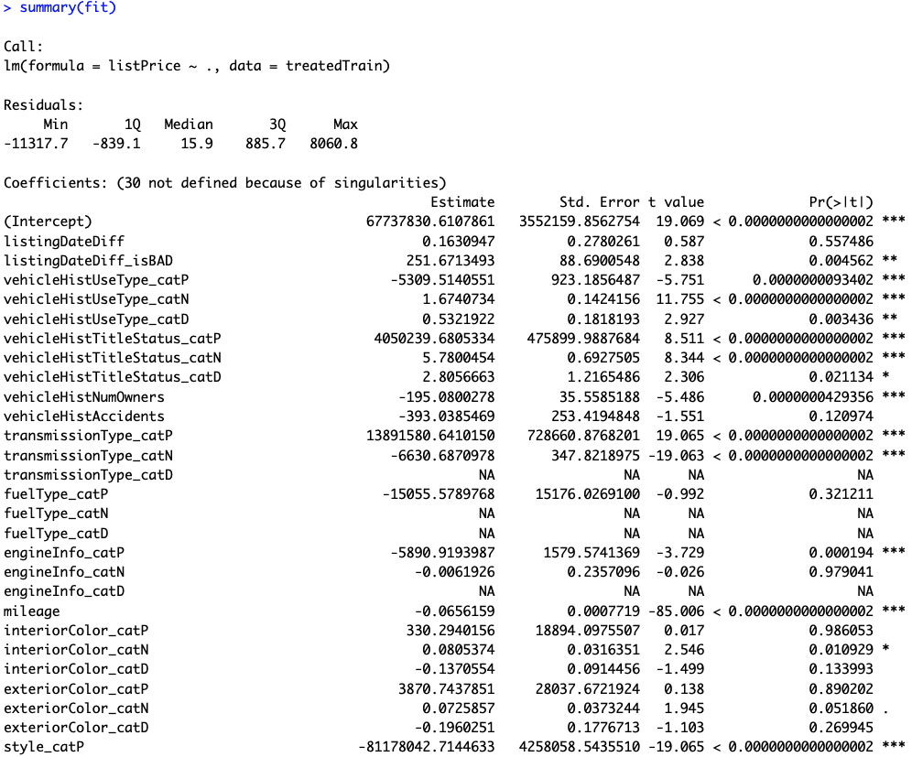
The Summary of the Fit
Auto ID of multi colinearity

Slide 45
The Summary of the Fit
P-Values
The probability of seeing a value larger than the t value.
Small p-values mean its less likely due to chance.

Slide 46
The Summary of the Fit
P-Values
In stats p <0.05 is good but in business I have seen p<0.2.
It’s a good idea to rebuild a model without variables that do not meet the cutoff.

Slide 47
Back to the script B

Slide 48
Parsimonious Model
Parsimony or compactness is desirable in models. The more features in a model, the more complexity we introduce, data integrity, data interactions, time to fit and time to predict are all impacted.
Notes:
We could drop yet another engineered variable but let’s continue. P =.175

Slide 49
Compare the two models
Fit1 – 98 variables
Fit2 – 29 variables

Slide 50
Evaluating a Prediction Model
RMSE- Root Mean Squared Error
y
y-hat
Actual Values | Predicted/Forecasted
10 | 16
12 | 8
20 | 17
36 | 34
Besides P-Values which is a variable level KPI, and adjusted R-Sq there are two popular KPI for evaluating continuous model predictions.

Slide 51
RMSE
RMSE- Root Mean Squared Error
y
y-hat
ERROR
ERROR-SQ
Actual Values | Predicted/Forecasted | Errors | Squared Errors
10 | 16 | -6 | 36
12 | 8 | 4 | 16
20 | 17 | 3 | 9
36 | 34 | 2 | 4
Mean
36+16+9+4
4
To manually calculate RMSE, work the acronym backwards.

Slide 52
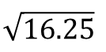
RMSE
RMSE- Root Mean Squared Error
ERROR
SQUARED
MEAN
ROOT
Actual Values | Predicted/Forecasted | Errors | Squared Errors
10 | 16 | -6 | 36
12 | 8 | 4 | 16
20 | 17 | 3 | 9
36 | 34 | 2 | 4
Mean
Square Root
36+16+9+4
$$\sqrt{16.25}$$
4
=4.03
In the same units being measured, tells you +/- the prediction error.

Slide 53

Back to script B
How good is Dale’s model?
Notes:
For the predict warning about rank deficient matrices:
Rank of the matrix is reduced since it throws out multi-collinear variables. Often can be safely ignored.

